Slide 1
Synthesizing realistic audio using generative adversarial networks
Justin Zhang

Slide 2
Audio
Stored as samples
Sample rate
A lot of data points
Storage
Hard to model

Slide 3
Let there be MIDI
Instrument, pitch, velocity, and time
Have gotten better but still sound terrible
Playback uses soundfonts
Contains actual sound samples
Does it sound good?

Slide 4

Take a listen
From the University of Arizona MIDI database (public domain) using a leading soundfont

Slide 5
Properties of instruments
Pitch
Initiation
Sustaining
Decay
Connecting with other notes
Timbre

Slide 6
Machine learning
Model learns itself
Gradients and genetic algorithms
Can effectively model organic data
Speech recognition
image classification

Slide 7
Spectrograms
Any wave signal can be represented as sinusoidal waves
Fourier transform
Magnitude and phase over frequency and time
Notes:
Sawtooth – all harmonics
Square – odd harmonics
Channels like image

Slide 8
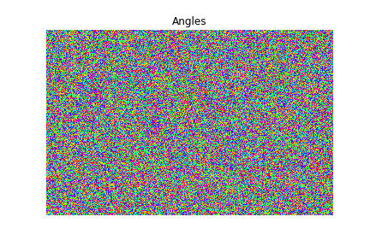
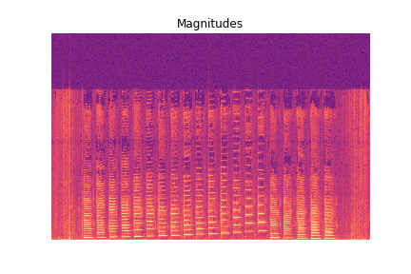
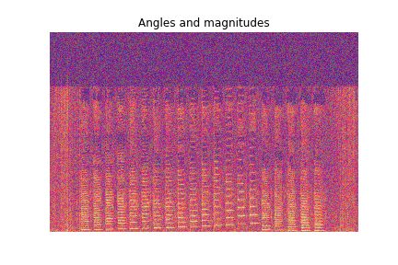
Generated using Librosa’s short term Fourier transform (stft) function

Slide 9
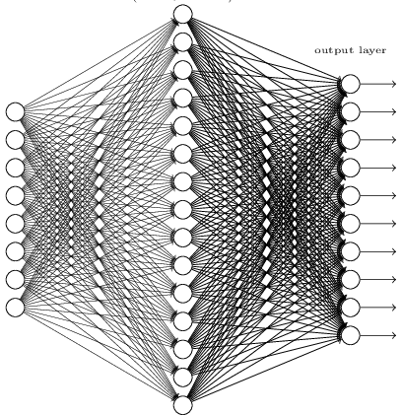

Neural networks (NNs)
Weights (w) on each edge between neuron output (x) to neuron, bias (b) at each node
A neuron outputs $∑w_{i}x_{i}+b$ passed through an activation function
Cost function
Backpropagation
From Michael Nielsen’s “Neural Networks and Deep Learning,” licensed under a Creative Commons Attribution-NonCommercial 3.0 Unported License.
Notes:
Each weight and bias is nudged

Slide 10
Convolutional Neural Networks (CNNs)
Same weights and biases for the whole image
Fewer parameters
Faster training
More accurate modeling
From Medium.com
Notes:
Why are CNNs good for images

Slide 11
Generative models
Classification vs generation
Generative adversarial networks (GANs)
Variational autoencoders (VAEs)

Slide 12
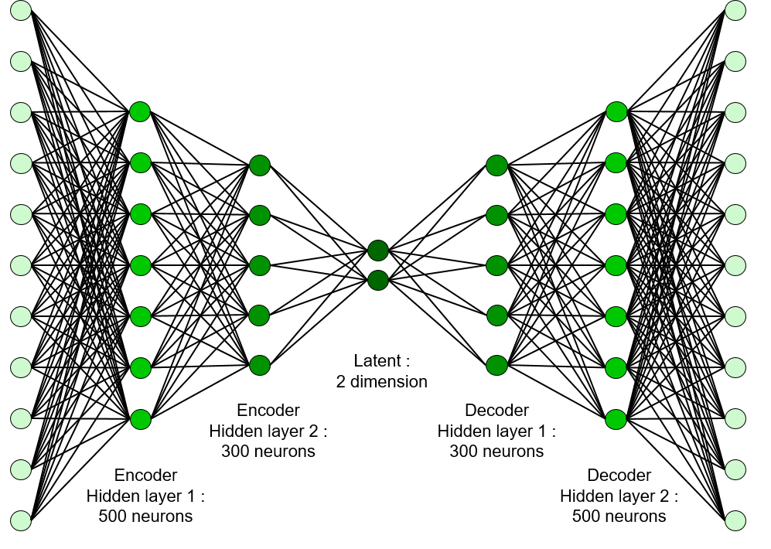
From Prof. Seungchul Lee’s GitHub
http://i-systems.github.io/HSE545/machine%20learning%20all/Workshop/CAE/06_CAE_Autoencoder.html

Slide 13
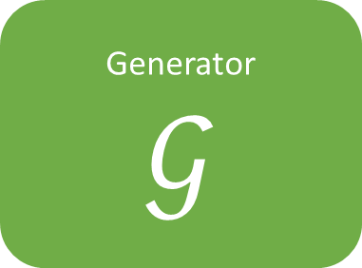
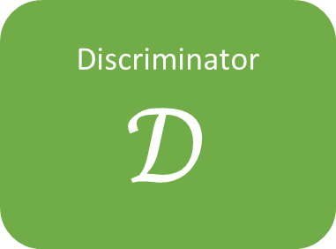
Generated picture
Generator
$$𝒢$$
Discriminator
$$𝒟$$
Real or fake?
Training picture
Latent space
Notes:
Why GAN over VAE?
Cost function less direct

Slide 14
Collecting data
Generating new data
Testing
Processing data
NSynth dataset of annotated audio from Engel et al. (2017)
Generate spectrograms from audio
Generative adversarial network
Listening to audio for quality
Extract phases and magnitudes from complex output
Tweak model hyperparameters
Import data into TensorFlow
Generate audio from spectrograms

Slide 15
References
Choi, K., Fazekas, G., Sandler, M., & Kyunghynn, C. (2017). Convolutional recurrent neural networks for music classification. ICASSP. doi:10.1109/ICASSP.2017.7952585, arXiv:1609.04243v3 [cs.NE]
Costa, Y. M. G., Oliveira, L. S., & Silla, C.N., Jr. (2017). An evaluation of convolutional nerual networks for music classification using spectrograms. Applied Soft Computing, 52(1), pp 28-38. doi:10.1016/j.asoc.2016.12.024
Creswell, A., White, T., Dumoulin, V., Arulkumaran, K., Sengupta, B., & Bharath, A. A. (2017). Generative adversarial networks: An overview. IEEE Signal Processing Magazine, 35(1), pp. 53-65. doi:10.1109/MSP.2017.2765202, arXiv:1710.07035v1 [cs.CV]
Engel, J., Resnick, C., Roberts, A., Dieleman, S., Eck, D., Simonyan, K., & Norouzi, M. (2017). Neural Audio Synthesis of Musical Notes with WaveNet Autoencoders. CoRR. arXiv:1710.07035 [cs.CV]
Goodfellow, I., Pouget-Abadie, J., Mirza, M., Xu, B., Warde-Farley, D., Ozair, S., … Bengio, Y. (2014). Generative adversarial nets. Advances in Neural Information Processing Systems, 27, pp. 2672–2680. arXiv:1406.2661 [stat.ML]
Pons, J., Slizovskaia, O., Gong, R., Gómez, E., & Serra, X. (2017). Timbre Analysis of Music Audio Signals with Convolutional Neural Networks. CoRR. arXiv:1703.06697 [cs.SD]
Radford, A., Metz, L., & Chintala, S. (2016). Unsupervised representation learning with deep convolutional generative adversarial networks. ILLR. arXiv:1511.06434 [cs.LG]

Slide 16
Things to fix
MORE PICTURES, LESS WORDS (at least 2 pics per slide, don’t do it by words if you can picture)
Axes on spectrograms, label
Better bridges/connecting each slide to the next
More color contrast in workflow
Better hook
Key for workflow
Two audio side by side for midi
Audio for spectrogram without phases
Justification for project, both now and final goal
Real life application
Which part of slides go under workflow
Cite Medium.com workflow
Label diagrams better (axes on spectrogram, title of vaes and gans)
Elaborate on classification vs generation, maybe remove that slide or expand that slide
Could connect to imputation, need better bridge from previous slide to that one
Connect VAEs and GANs: encoder and generator parallel, how latent spaces connect

